Slide 1
A quick tour of spectral vegetation indices
Ian Breckheimer
BIOL 697, March 1st 2023

Slide 2
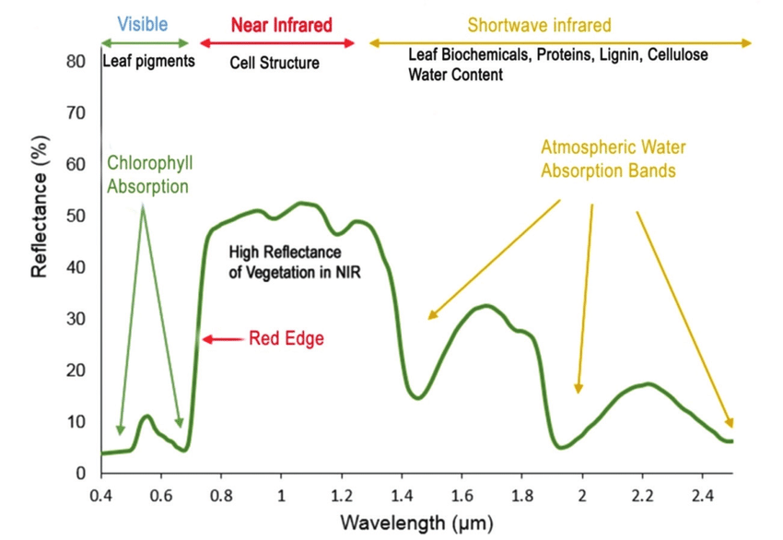
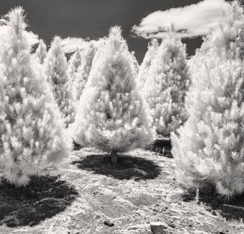
Vegetation Reflectance Spectrum
Images: lisakimmorley.com, Wikimedia commons

Slide 3
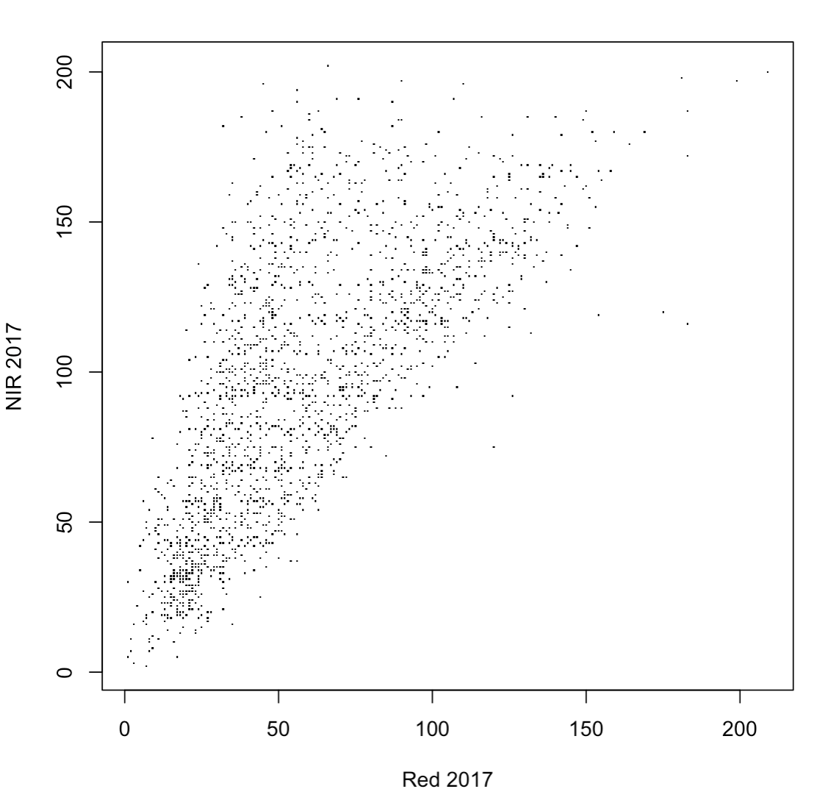
Why indices instead of reflectance values?
Simplicity—one variable instead of 2-4+.
Reflectance often strongly correlated across bands, so they are not independent.
Stability— Indices often less sensitive to artifacts. Effects of topography, view angle, shadows) often similar across bands.

Slide 4
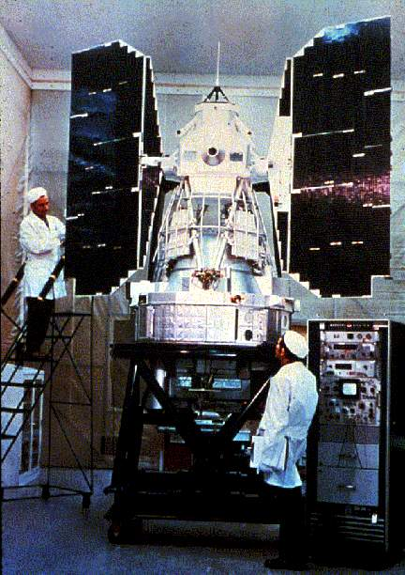
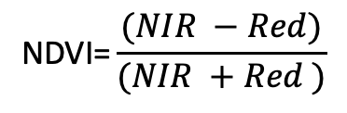
NDVI (Normalized Difference Vegetation Index)
Grandaddy of all vegetation indices (Rouse 1973)
$$\text{NDVI}\text{=}\frac{(NIR −Red)}{(NIR +Red )}$$
Landsat 1
Images: Wikimedia commons

Slide 5
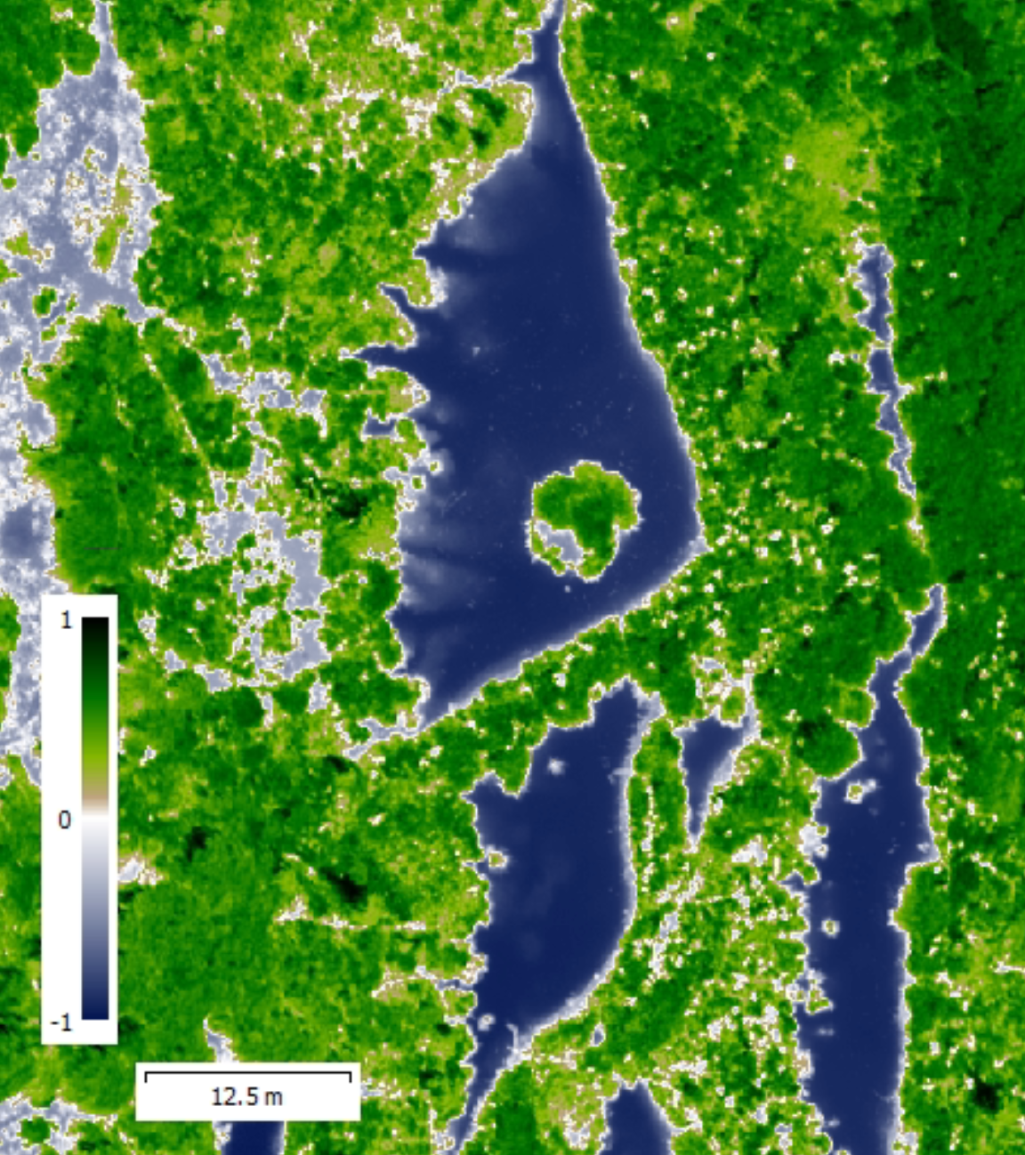
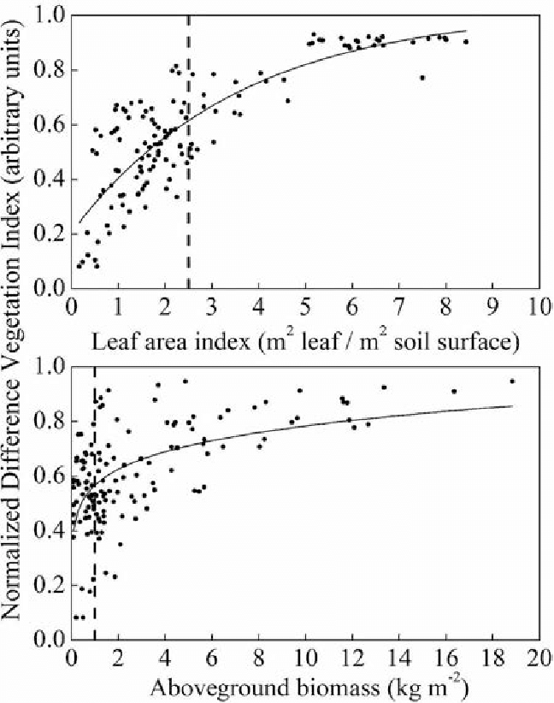
Shortcomings of NDVI
Background (soil, water) effects.
Saturation at high plant cover.
Related to plant structure, not function.

Slide 6

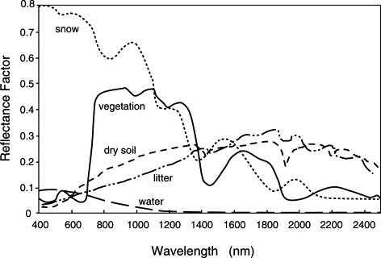
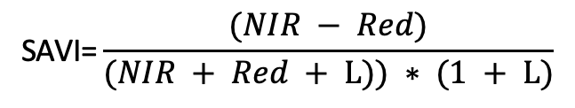
2nd Generation Alternatives
Vis.
Soil-adjusted Vegetation Index (SAVI)
Near IR (NIR)
Shortwave IR (SWIR)
$$\text{SAVI}\text{=}\frac{(NIR − Red)}{(NIR + Red + L)) ∗ (1 + L)}$$
L is a fit constant that maximizes
differences between vegetation and soil.
Most useful in sparse vegetation environments (e.g. drylands)
with lots of variation in soil properties.
Image: Wikimedia commons

Slide 7
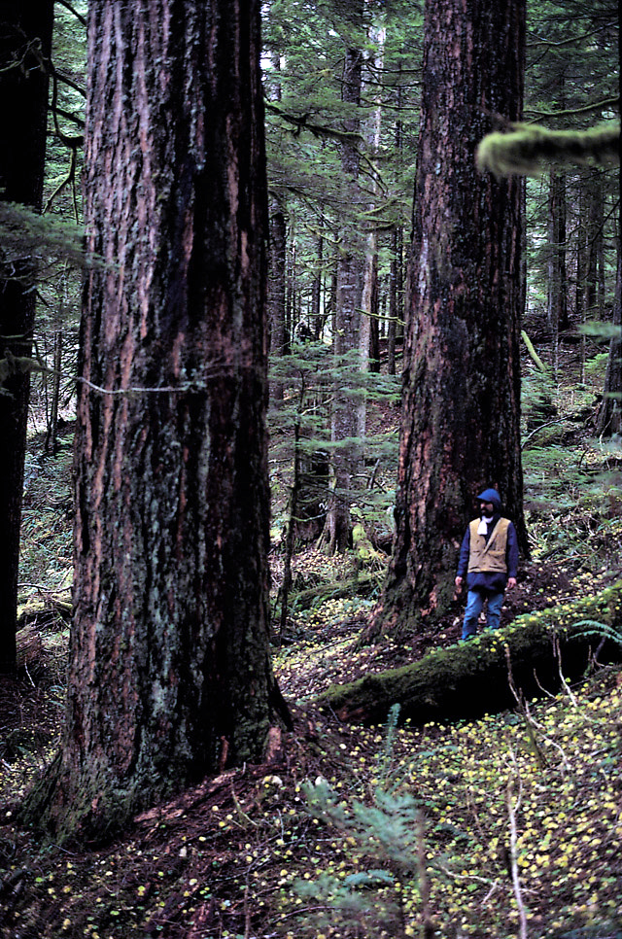
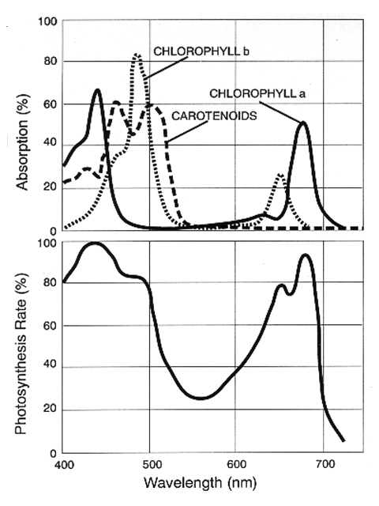
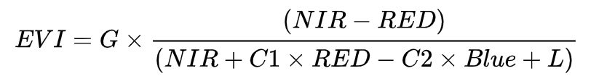
2nd Generation Alternatives
Enhanced Vegetation Index (EVI) and EVI2.
G, C1, C2, and L are fit constants that maximize
differences between vegetation and background.
Ditches the Blue
Blue
Red
Images: Wikimedia commons

Slide 8
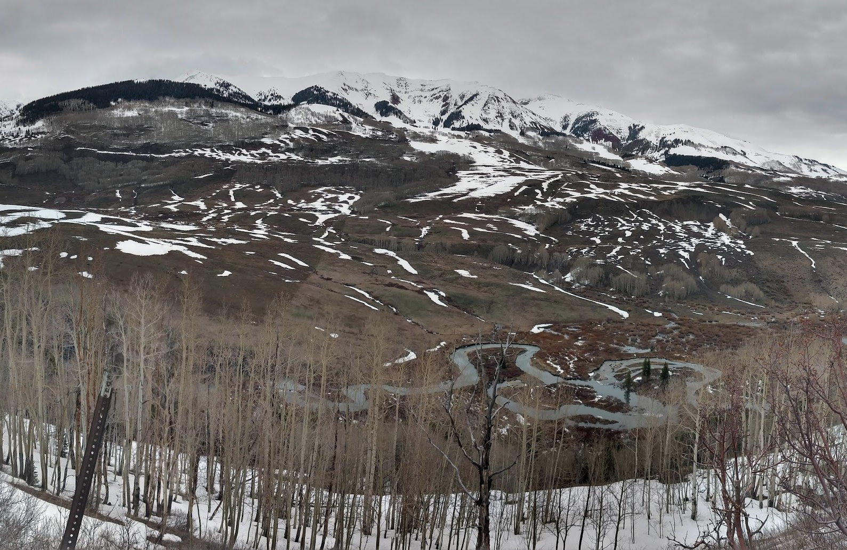
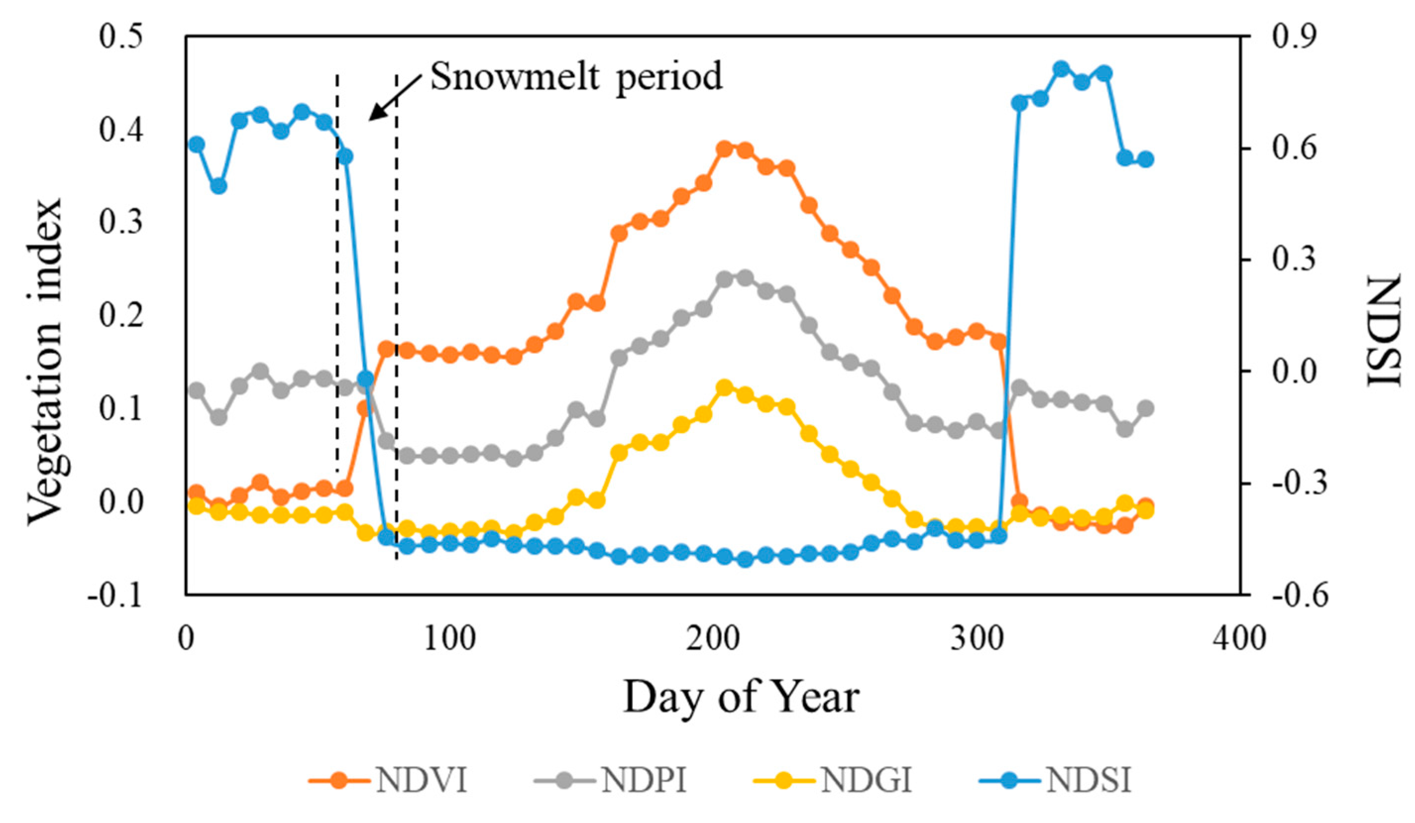
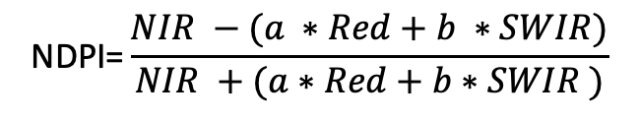
2nd Generation Alternatives
Normalized Difference Phenology Index (NDPI, Wang et al. 217)
$$\text{NDPI}\text{=}\frac{NIR −(a ∗Red+b ∗SWIR)}{NIR +(a∗Red+b∗SWIR )}$$
a and b are fit constants that minimize
differences between snow and soil
Figure: Cao et al. 2020

Slide 9

3rd Generation Alternatives
Optimized for detecting plant productivity (e.g. GPP) not structure.
NIRv – Near-infrared Reflectance of Vegetation (Badgley et al. 2019)
$$\text{NIRv}\text{=}\text{NDVI}\text{[}\text{NDVI}\text{ > 1] ∗ }\text{NIR}$$
Proxy for leaf area.
Proxy for
absorbed PAR

Slide 10
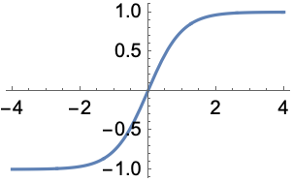
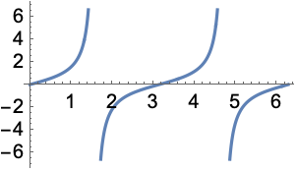
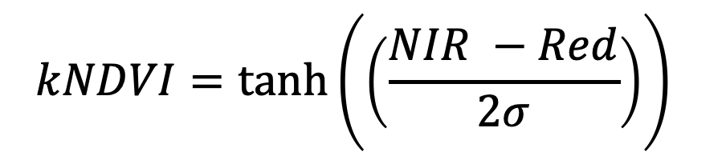
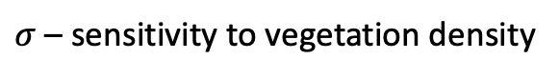
3rd Generation Alternatives
Optimized for detecting plant productivity (e.g. GPP) not structure.
kNDVI – Kernel NDVI (Camps-Valls et al. 2021)
$$kNDVI=\tanh\left(\left(\frac{NIR −Red}{2σ}\right)\right)⁡$$
$σ$– sensitivity to vegetation density
tanh(x)
tan(x)

Slide 11
So when should you use these?
Do you have good field data on vegetation
cover, productivity, or biomass?
Yes
Don’t use a VI, predict the target directly.
No
Do your scenes have snow
Or super steep terrain?
Yes
Go with NDVI or NDPI
No
Do your scenes have lots of
soil and sparse vegetation?
Yes
SAVI or MSAVI
No
Do your scenes have very dense veg (e.g. forests)?
Yes
EVI or EVI2
No
Yes
NIRv or kNDVI
Are you more interested in function (productivity) than veg. structure?
No
NDVI is fine

Slide 12
Key points
Spectral vegetation indices (VIs) are simple, relatively stable measurements that take advantage of unique spectral features of green vegetation.
NDVI is the simplest and oldest VI, and it performs well in many contexts (but not all).
In recent decades, other indices have been developed to optimize for particular goals or overcome particular shortcomings.
Indices optimized for a particular purpose sometimes perform worse in other ways.
Often it makes sense to try/use more than one and compare.

Slide 13
References
Rouse, J.W, Haas, R.H., Scheel, J.A., and Deering, D.W. (1974) 'Monitoring Vegetation Systems in the Great Plains with ERTS.' Proceedings, 3rd Earth Resource Technology Satellite (ERTS) Symposium, vol. 1, p. 48 62.
Wang, C., Chen, J., Wu, J., Tang, Y., Shi, P., Black, T. A., & Zhu, K. (2017). A snow-free vegetation index for improved monitoring of vegetation spring green-up date in deciduous ecosystems. Remote sensing of environment, 196, 1-12.
Badgley, G., Anderegg, L. D., Berry, J. A., & Field, C. B. (2019). Terrestrial gross primary production: Using NIRV to scale from site to globe. Global change biology, 25(11), 3731-3740.
Camps-Valls, G., Campos-Taberner, M., Moreno-Martínez, Á., Walther, S., Duveiller, G., Cescatti, A., ... & Running, S. W. (2021). A unified vegetation index for quantifying the terrestrial biosphere. Science Advances, 7(9), eabc7447.

